Slide 1
Regulacija genske ekspresije kod eukariota

Slide 2
Pregled - prokarioti
Prokarioti i eukarioti mijenjaju ekspresiju gena obzirom na promjene u okolišu
Genska ekspresija kod prokariota se kontrolira preko operon modela
Stanice mogu regulirati produkciju enzima preko povratne sprege ili preko regulacije gena

Slide 3
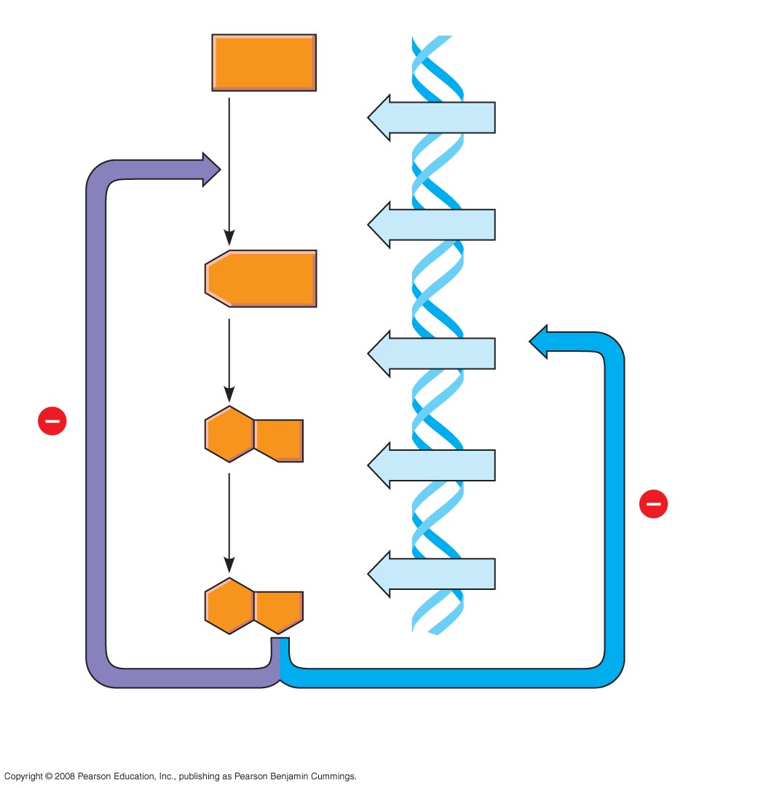
Fig. 18-2
Precursor
Feedback
inhibition
trpE gene
Enzyme 1
trpD gene
Regulation
of gene
expression
Enzyme 2
trpC gene
trpB gene
Enzyme 3
trpA gene
Tryptophan
(a) Regulation of enzyme
activity
(b) Regulation of enzyme
production
Notes:
Figure 18.2 Regulation of a metabolic pathway

Slide 4
Eukarioti
Svi organizmi moraju regulirati ekspresiju gena jako precizno – vrijeme, mjesto i kao odgovor na promjene u okolišu
Kod višestaničnih organizama regulacije ekspresije gena je neophodna za specijalizaciju stanica
Notes:
Almost all the cells in an organism are genetically identical
Differences between cell types result from differential gene expression, the expression of different genes by cells with the same genome
Errors in gene expression can lead to diseases including cancer
Gene expression is regulated at many stages

Slide 5
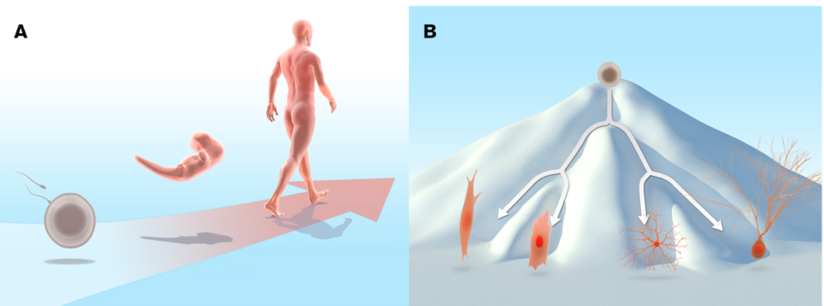

Slide 6
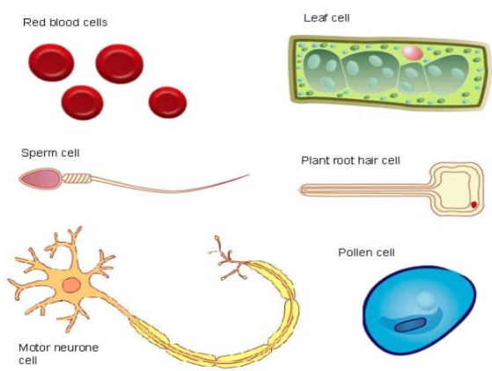
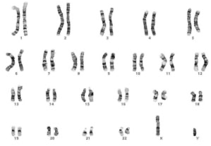
Diferencijalna ekspresija gena u organizmu

Slide 7
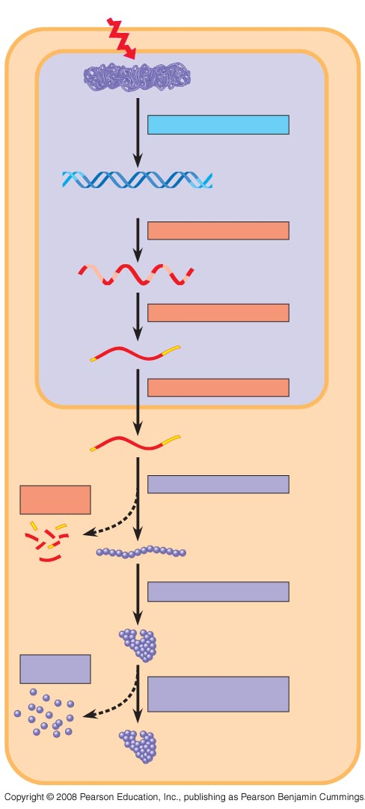
Fig. 18-6
Signal
NUCLEUS
Chromatin
Chromatin modification
DNA
Gene available
for transcription
Gene
Transcription
RNA
Exon
Primary transcript
Intron
RNA processing
Tail
Cap
mRNA in nucleus
Transport to cytoplasm
CYTOPLASM
mRNA in cytoplasm
Degradation
of mRNA
Translation
Polypeptide
Protein processing
Degradation
of protein
Active protein
Transport to cellular
destination
Cellular function
Notes:
Figure 18.6 Stages in gene expression that can be regulated in eukaryotic cells

Slide 8
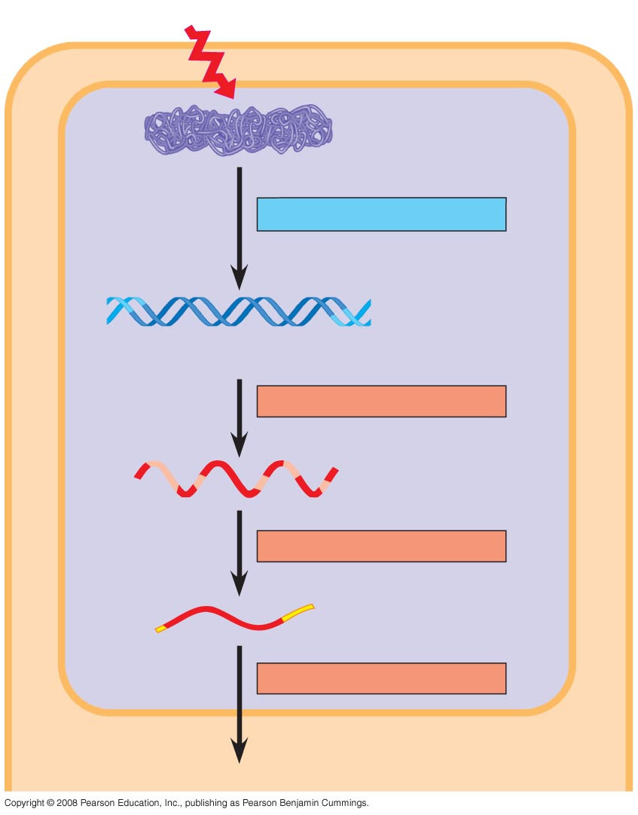
Fig. 18-6a
Signal
NUCLEUS
Chromatin
Chromatin modification
DNA
Gene available
for transcription
Gene
Transcription
RNA
Exon
Primary transcript
Intron
RNA processing
Tail
Cap
mRNA in nucleus
Transport to cytoplasm
CYTOPLASM
Notes:
Figure 18.6 Stages in gene expression that can be regulated in eukaryotic cells

Slide 9
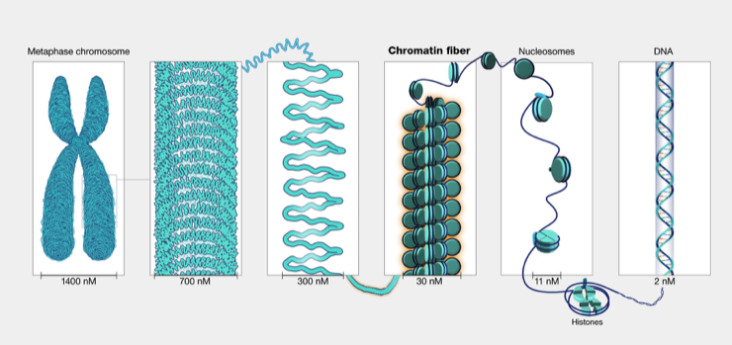

Slide 10
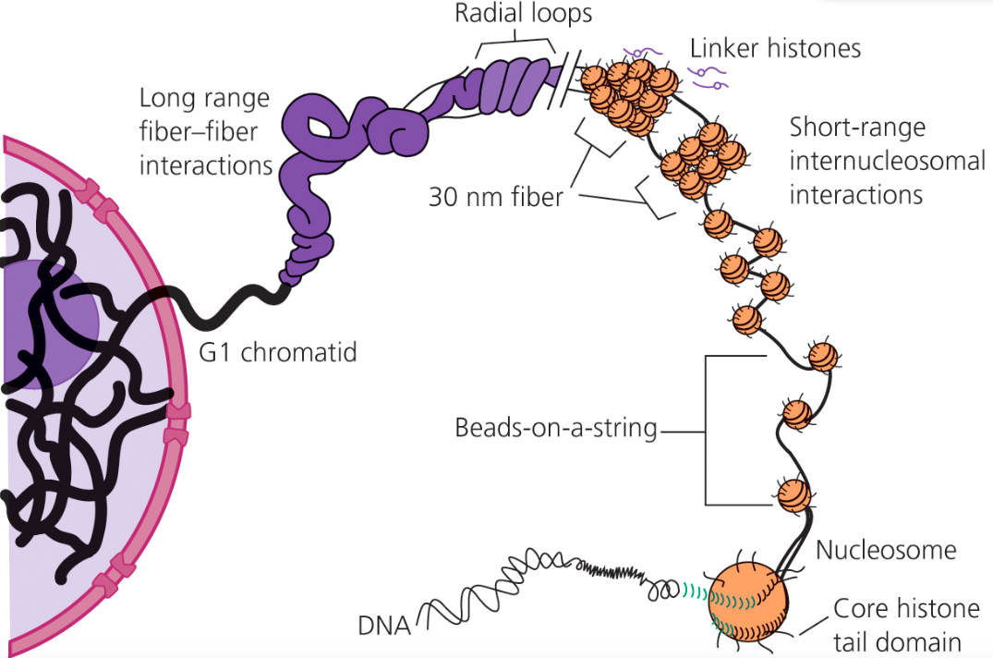
Struktura kromatina
Notes:
147 bp omotano oko histonskog kompleksa(2x H2A, H2B, H3 i H4)

Slide 11
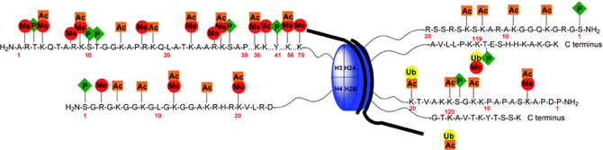
Modifikacije histona
Acetilacija
Metilacija
Fosforilacija
Ubikvitinacija

Slide 12
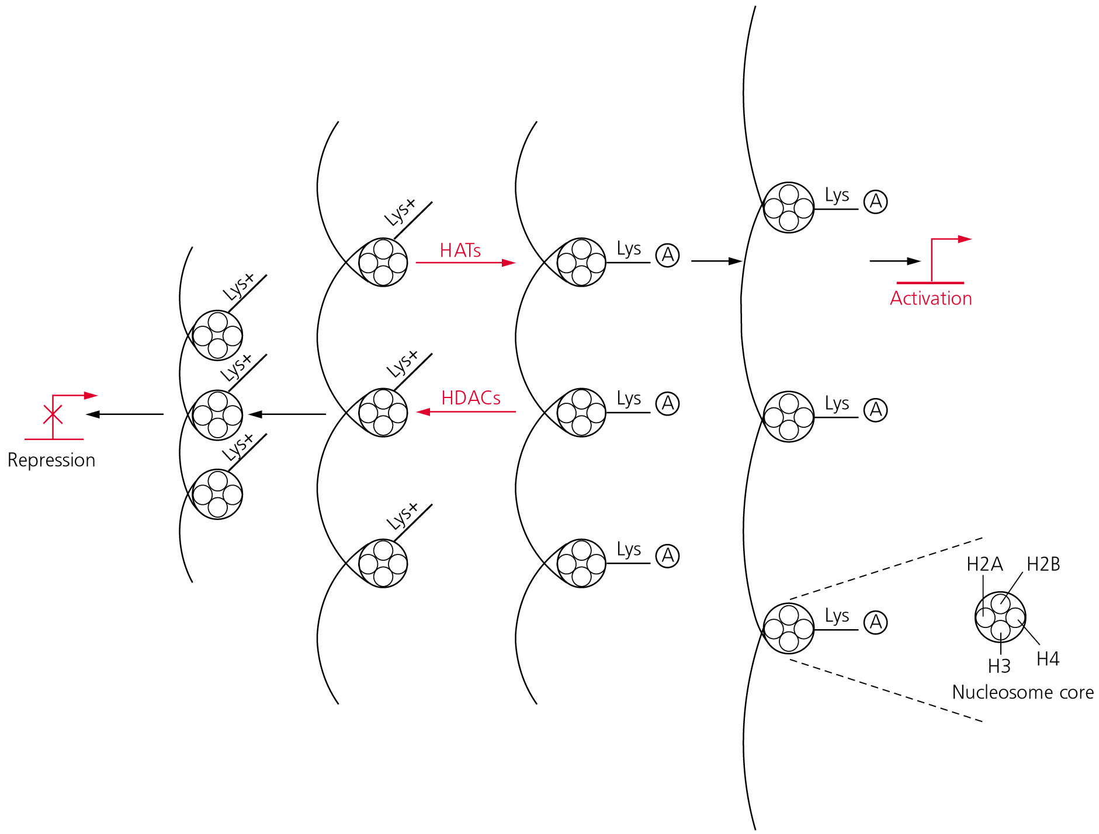
Acetilacija histona

Slide 13
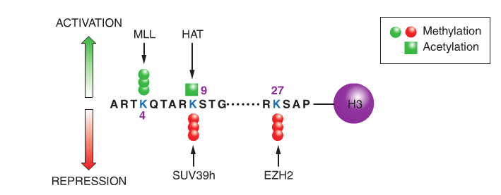
Acetilacija i metilacija histona H3

Slide 14
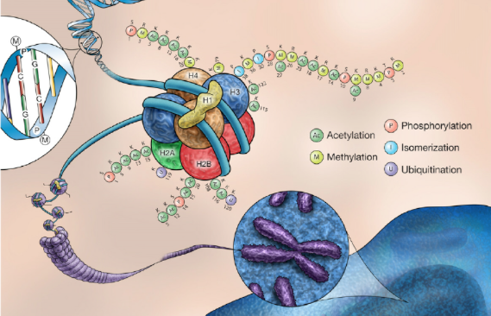
Modifikacije kromatina

Slide 15
https://www.youtube.com/watch?v=XelGO582s4U

Slide 16
Fig. 18-6a
Signal
NUCLEUS
Chromatin
Chromatin modification
DNA
Gene available
for transcription
Gene
Transcription
RNA
Exon
Primary transcript
Intron
RNA processing
Tail
Cap
mRNA in nucleus
Transport to cytoplasm
CYTOPLASM
Notes:
Figure 18.6 Stages in gene expression that can be regulated in eukaryotic cells

Slide 17
Organizacija tipičnog eukariotskog gena
Regulatorna i kodirajuća regija
Kontrolni elementi se vežu na nekodirajuću regiju i reguliraju transkripciju preko proteina koji se vežu na njih

Slide 18
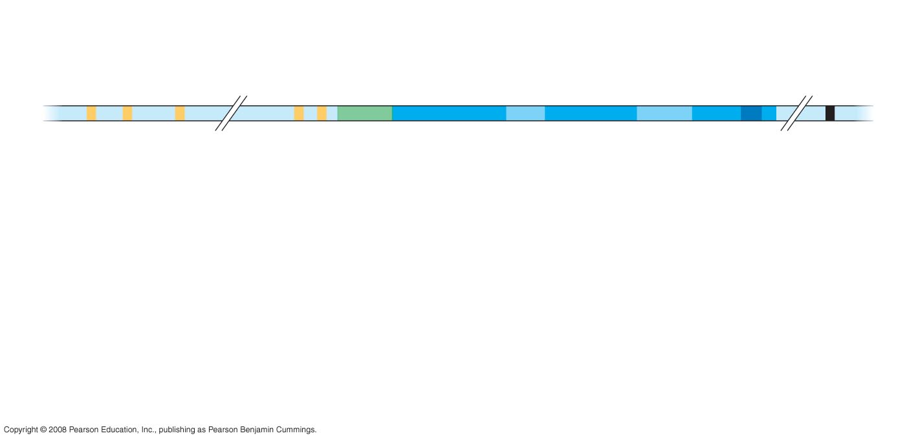
Fig. 18-8-1
Poly-A signal
sequence
Enhancer
(distal control elements)
Proximal
control elements
Termination
region
Exon
Intron
Exon
Intron
Exon
DNA
Upstream
Promoter
Downstream
Notes:
Figure 18.8 A eukaryotic gene and its transcript

Slide 19
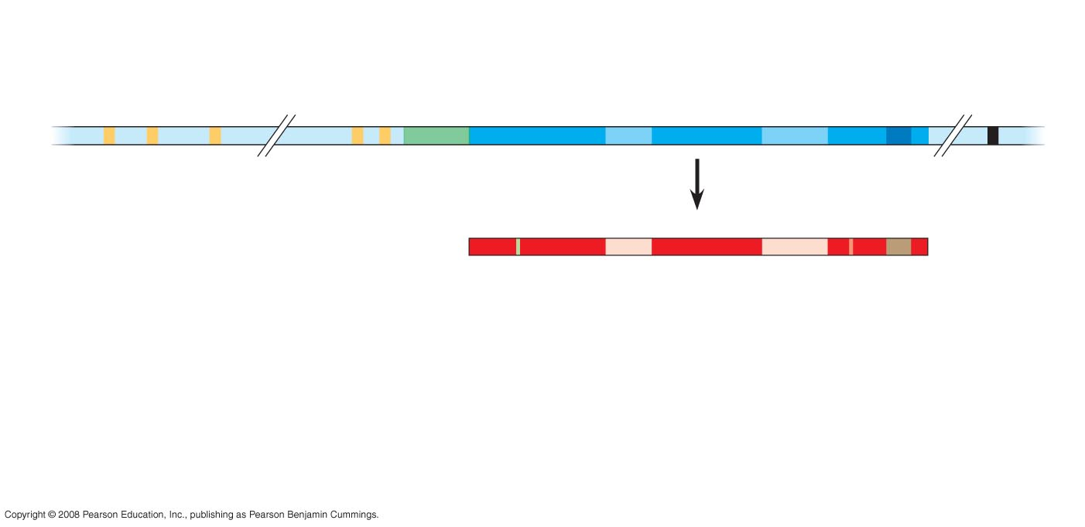
Fig. 18-8-2
Poly-A signal
sequence
Enhancer
(distal control elements)
Proximal
control elements
Termination
region
Exon
Intron
Exon
Intron
Exon
DNA
Upstream
Promoter
Downstream
Transcription
Primary RNA
transcript
Exon
Intron
Exon
Intron
Exon
Cleaved 3 end
of primary
transcript
5
Poly-A
signal
Notes:
Figure 18.8 A eukaryotic gene and its transcript

Slide 20
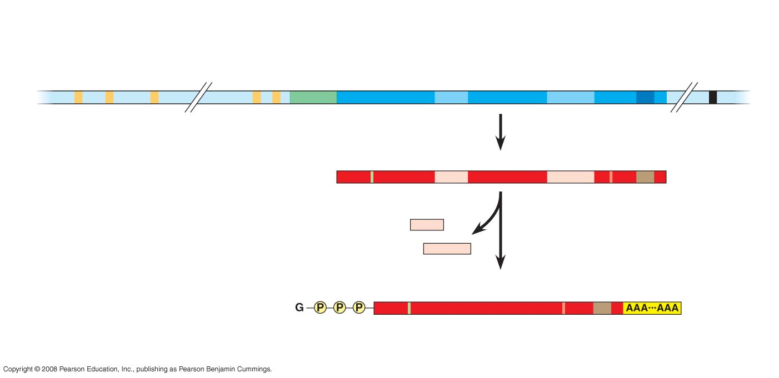
Fig. 18-8-3
Poly-A signal
sequence
Enhancer
(distal control elements)
Proximal
control elements
Termination
region
Exon
Intron
Exon
Intron
Exon
DNA
Upstream
Promoter
Downstream
Transcription
Primary RNA
transcript
Exon
Intron
Exon
Intron
Exon
Cleaved 3 end
of primary
transcript
5
RNA processing
Intron RNA
Poly-A
signal
Coding segment
mRNA
3
5 Cap
Start
codon
Stop
codon
3 UTR
Poly-A
tail
5 UTR
Notes:
Figure 18.8 A eukaryotic gene and its transcript

Slide 21
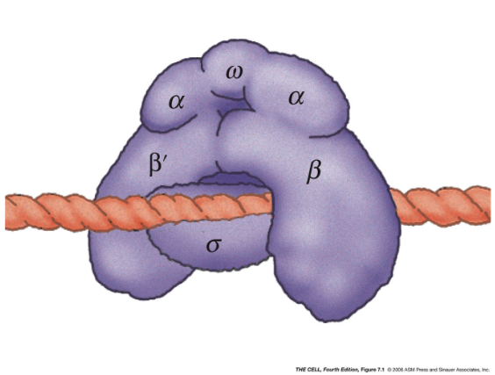
RNA polimeraza kod prokariota
Sinteza RNA na DNA kalupu samo u 5’ – 3’ smjeru
Nije potrebna početnica
Sadrzi 5 podjedinica
Veže se na promotore gena

Slide 22
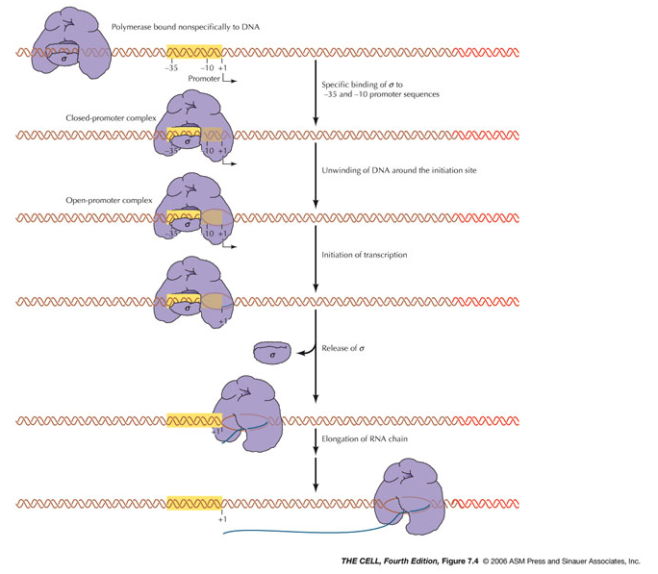
Sinteza RNA

Slide 23
Transkripcija u eukariotima
Znatno složeniji proces s tri bitne razlike:
1. više RNA polimeraza (I, II i III)
2. potrebni interakcijski partneri za vezanje na promotore (TF)
3. transkripcija se odvija na kromatinu te je potrebna regulacija kromatinske strukture

Slide 24
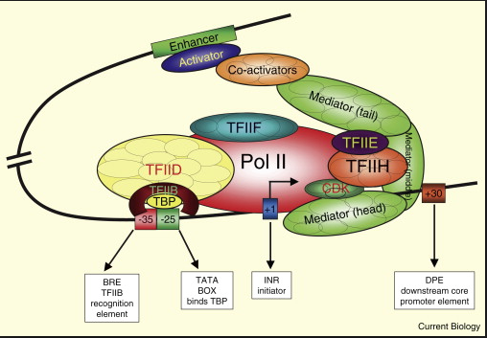
RNA polimeraza II

Slide 25
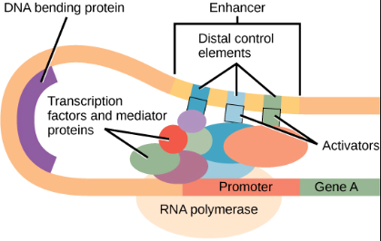
Regulacija ekspresije u eukariotskim stanicama
Pojačivači i utišavači
Transkripcijski faktori
Transkripcijski aktivatori
Transkripcijski represori
- Interakcija s transkripcijskim sustavom
- Modifikacija kromatinske strukture
Notes:
To initiate transcription, eukaryotic RNA polymerase requires the assistance of proteins called transcription factors
General transcription factors are essential for the transcription of all protein-coding genes
In eukaryotes, high levels of transcription of particular genes depend on control elements interacting with specific transcription factors
Proximal control elements are located close to the promoter
Distal control elements, groups of which are called enhancers, may be far away from a gene or even located in an intron
An activator is a protein that binds to an enhancer and stimulates transcription of a gene
Bound activators cause mediator proteins to interact with proteins at the promoter

Slide 26
Fig. 18-6a
Signal
NUCLEUS
Chromatin
Chromatin modification
DNA
Gene available
for transcription
Gene
Transcription
RNA
Exon
Primary transcript
Intron
RNA processing
Tail
Cap
mRNA in nucleus
Transport to cytoplasm
CYTOPLASM
Notes:
Figure 18.6 Stages in gene expression that can be regulated in eukaryotic cells

Slide 27
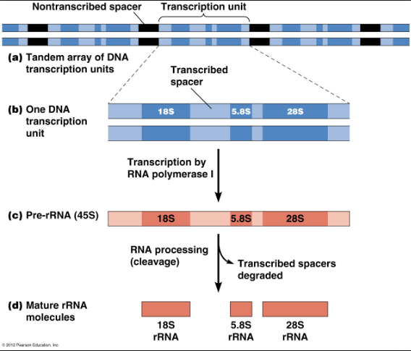
Doradba i promet rRNA

Slide 28
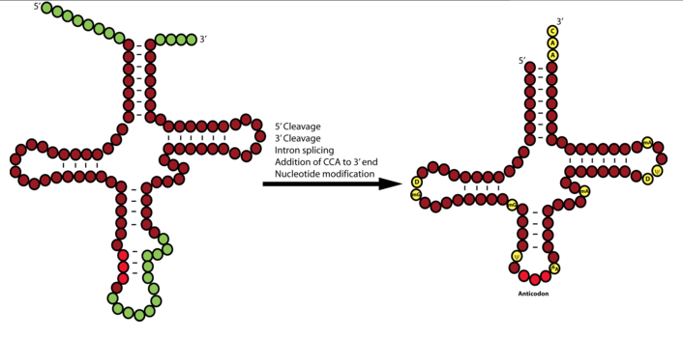
Doradba i promet tRNA

Slide 29
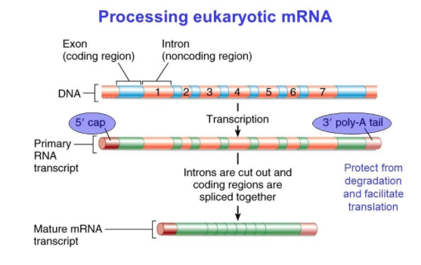
Doradba i promet mRNA

Slide 30
https://www.youtube.com/watch?v=aVgwr0QpYNE

Slide 31
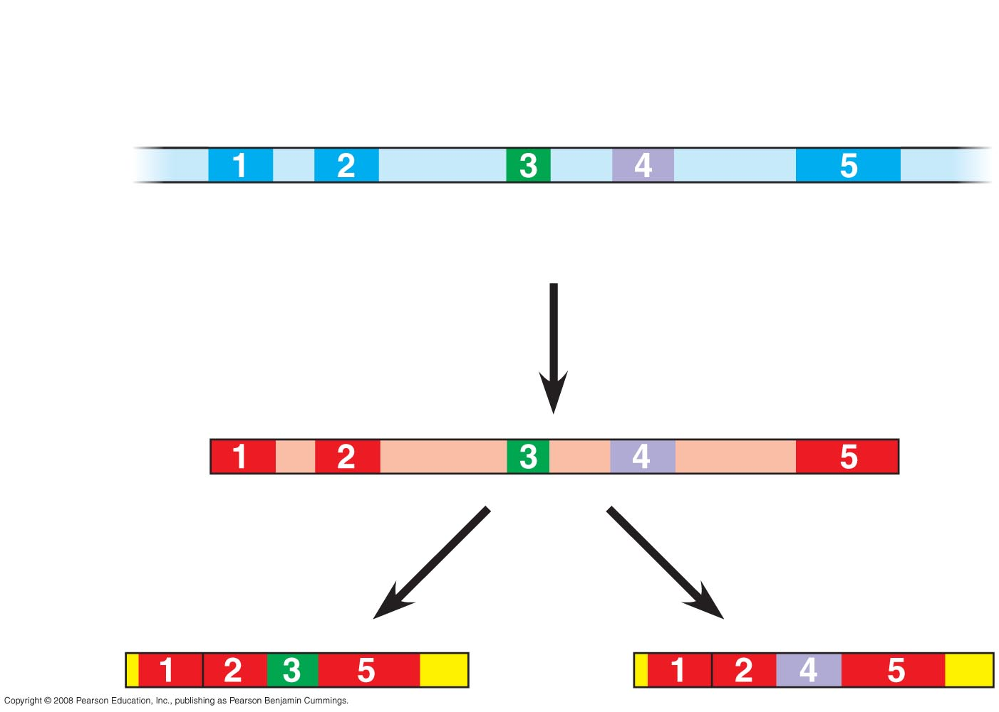
Fig. 18-11
Exons
DNA
Troponin T gene
Primary
RNA
transcript
RNA splicing
mRNA
or
Notes:
Figure 18.11 Alternative RNA splicing of the troponin T gene

Slide 32
Fig. 18-6a
Signal
NUCLEUS
Chromatin
Chromatin modification
DNA
Gene available
for transcription
Gene
Transcription
RNA
Exon
Primary transcript
Intron
RNA processing
Tail
Cap
mRNA in nucleus
Transport to cytoplasm
CYTOPLASM
Notes:
Figure 18.6 Stages in gene expression that can be regulated in eukaryotic cells

Slide 33
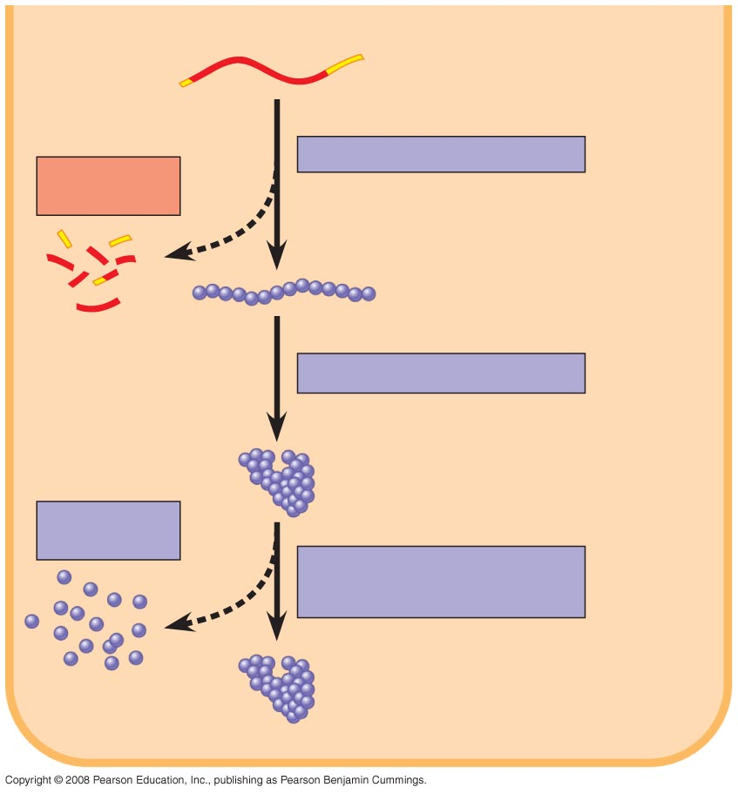
Fig. 18-6b
CYTOPLASM
mRNA in cytoplasm
Degradation
of mRNA
Translation
Polypeptide
Protein processing
Active protein
Degradation
of protein
Transport to cellular
destination
Cellular function
Notes:
Figure 18.6 Stages in gene expression that can be regulated in eukaryotic cells

Slide 34
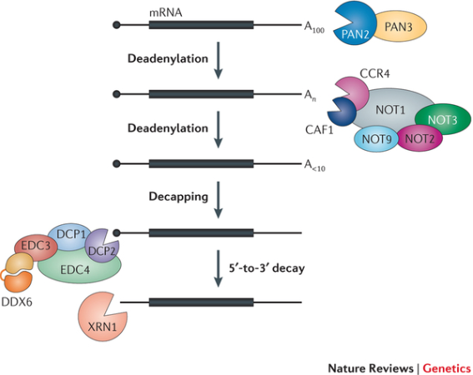
Razgradnja RNA kao mehanizam kontrole ekspresije gena

Slide 35
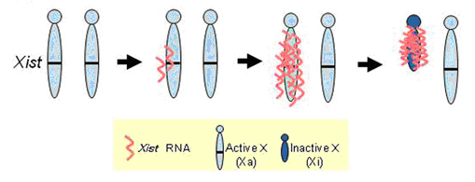
Nekodirajuće RNA igraju ulogu u kontroli genske ekspresije
Samo mali udio DNA kodira za proteine i strukturne RNA
Veliki udio se transkribira u nekodirajuće RNA
Nekodirajuće RNA reguliraju ekspresiju gena na razini translacije i konfiguracije kromatina

Slide 36
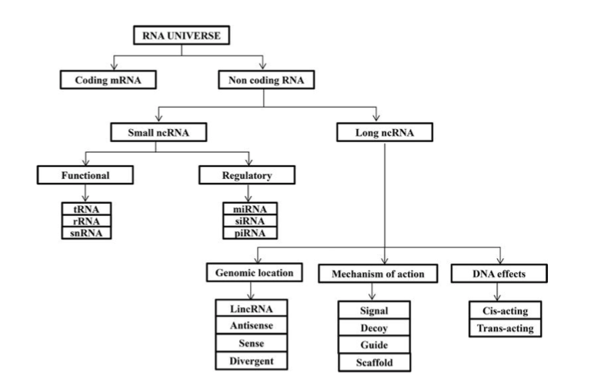
RNA svijet

Slide 37
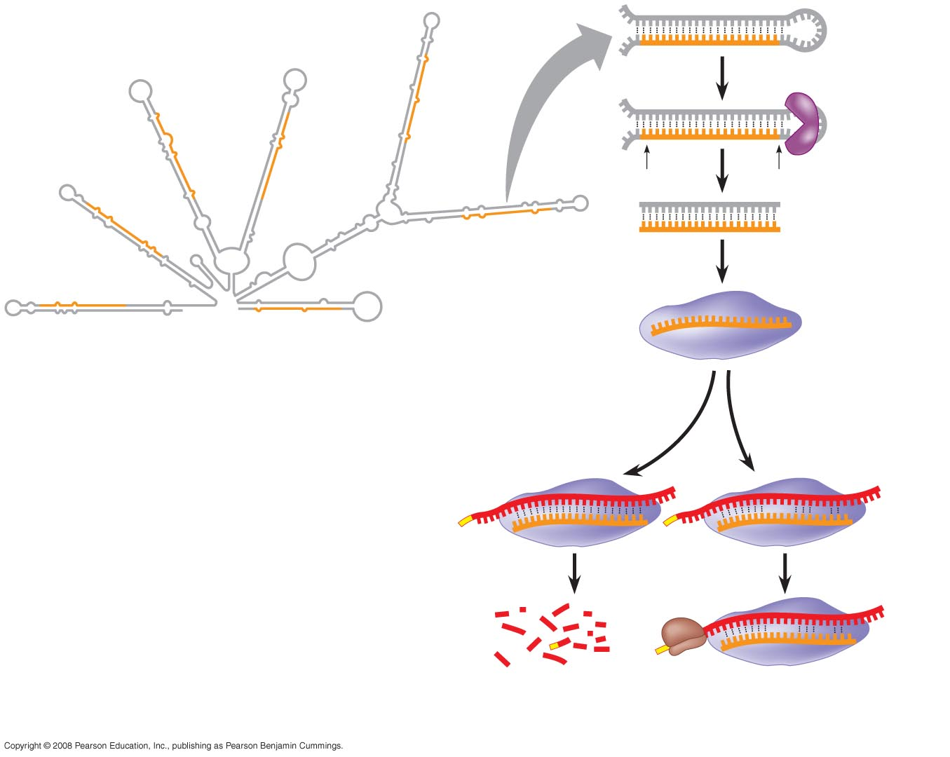
Fig. 18-13
Hairpin
miRNA
Hydrogen
bond
Dicer
miRNA
miRNA-
protein
complex
5
3
(a) Primary miRNA transcript
mRNA degraded
Translation blocked
(b) Generation and function of miRNAs
Notes:
Figure 18.13 Regulation of gene expression by miRNAs
The phenomenon of inhibition of gene expression by RNA molecules is called RNA interference (RNAi)
RNAi is caused by small interfering RNAs (siRNAs)
siRNAs and miRNAs are similar but form from different RNA precursors

Slide 38
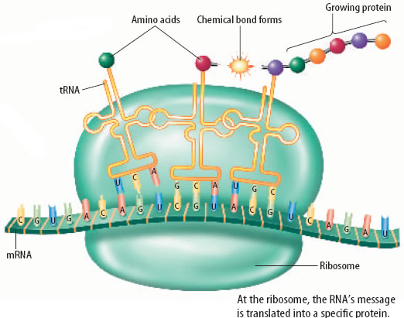
Sinteza, doradba i regulacija proteina

Slide 39
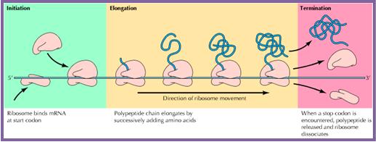
Inicijacija, elongacija i terminacija

Slide 40
https://www.youtube.com/watch?v=TfYf_rPWUdY

Slide 41
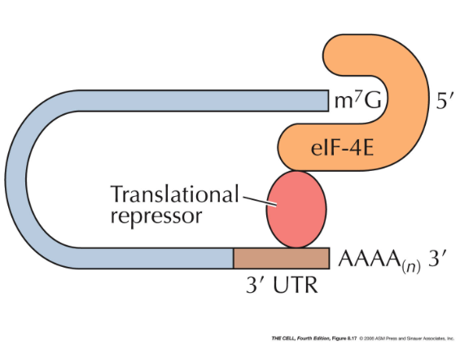
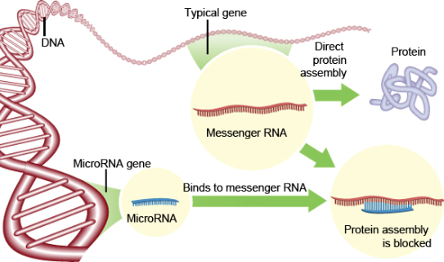
Regulacija translacije
Represori translacije
Nekodirajuće mikroRNA

Slide 42
Smatanje i doradba proteina
Pravilno smatanje - šaperoni
Udruživanje u komplekse – interakcijske domene
Modifikacije (vezanje ugljikohidrata i lipida, kidanje kovalentnih veza)

Slide 43
Razgradnja proteina
Razgradnja u proteasomu nakon ubikvitinacije
Lizosomska proteoliza

Slide 44
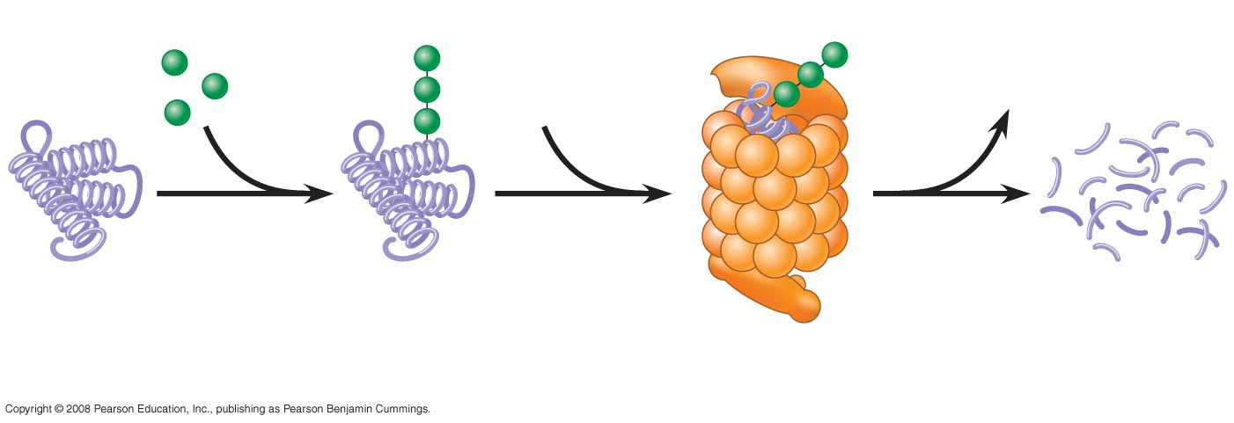
Fig. 18-12
Proteasome
and ubiquitin
to be recycled
Ubiquitin
Proteasome
Protein to
be degraded
Ubiquitinated
protein
Protein
fragments
(peptides)
Protein entering a
proteasome
Notes:
Figure 18.12 Degradation of a protein by a proteasome

Slide 45
Sažetak
Regulacija genske ekspresije odvija se na nivou transkripcije, translacije, doradbe i degradacije
Sinteza RNA:
Prepisivanje u RNA (aktivatori, respresori, pojačivači, utišavači)
Struktura kromatina (metilacija DNA, modifikacije histona)
Doradba RNA
Izrezivanje introna, degradacija
Sinteza proteina
Represori translacije, mikroRNA
Doradba proteina
Smatanje, modifikacije, degradacija

Slide 46
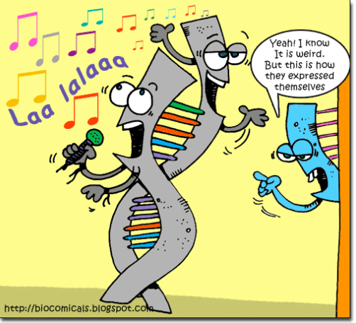

Slide 47
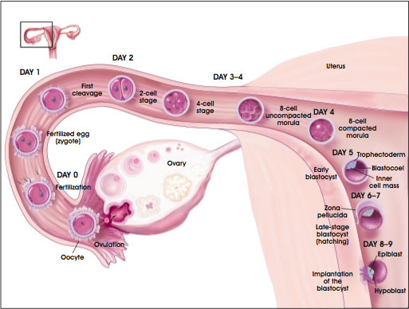
Fertilization https://www.youtube.com/watch?v=UgT5rUQ9EmQ

Slide 48
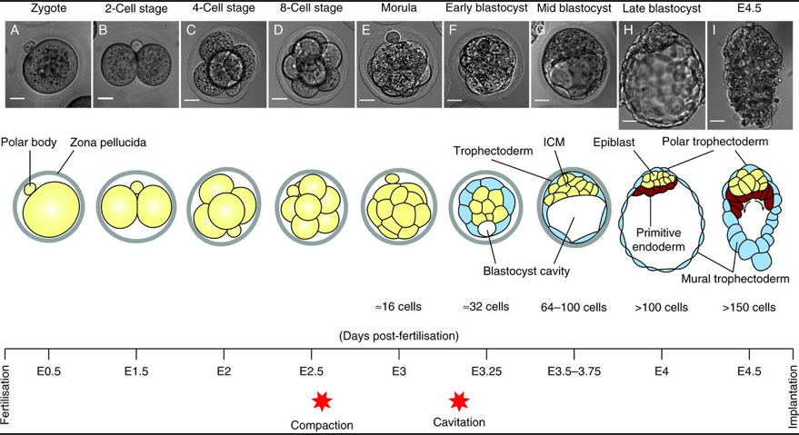
Preimplantation development

Slide 49
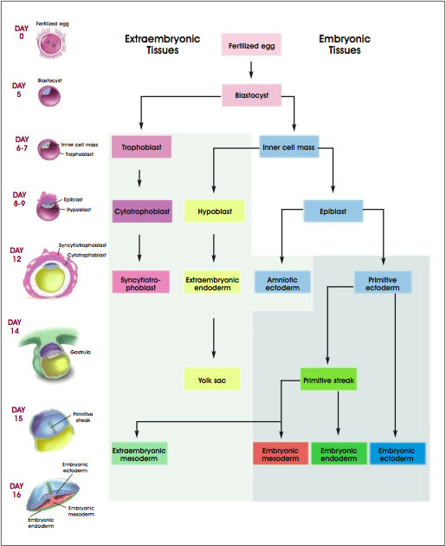

Slide 50
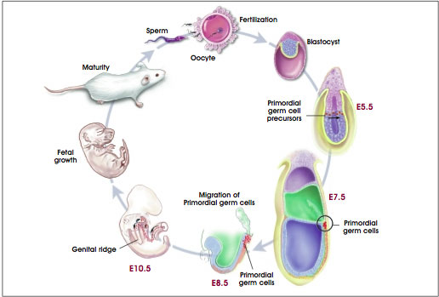
Primordial germ cells

Slide 51
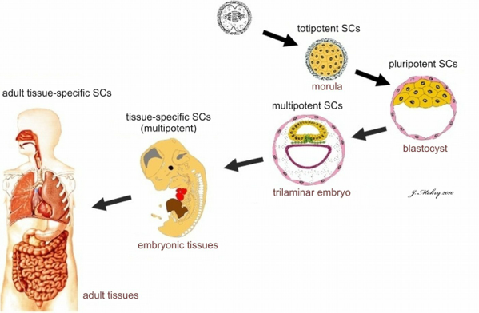
Stem cells during development

Slide 52
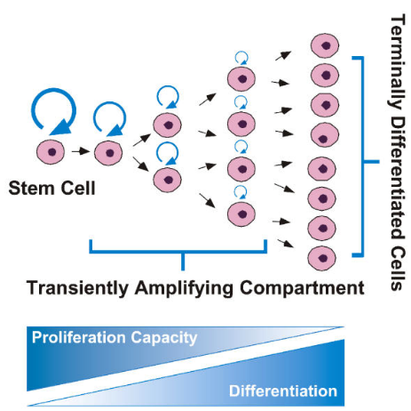
Tissue compartment

Slide 53
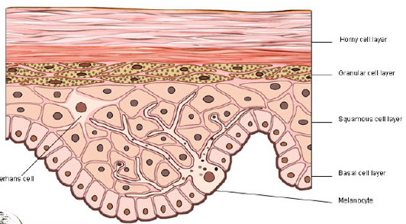
Primjer pločastog epitela

Slide 54
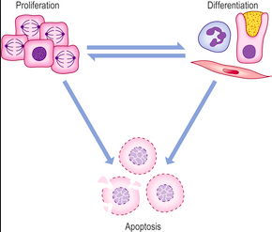
Sudbina stanice u tkivu

Slide 55
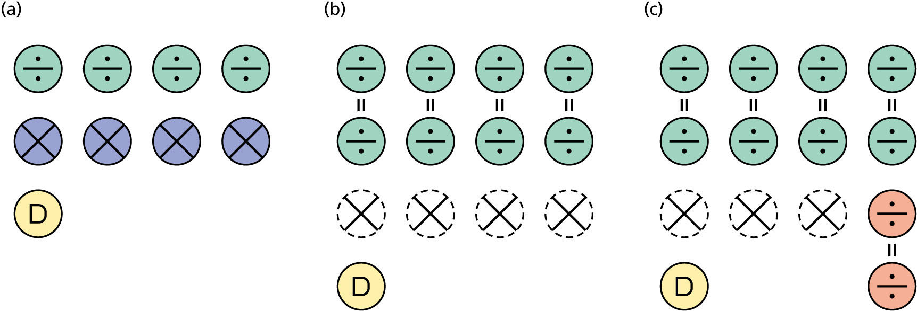
Proliferacija, diferencijacija i apoptoza

Slide 56
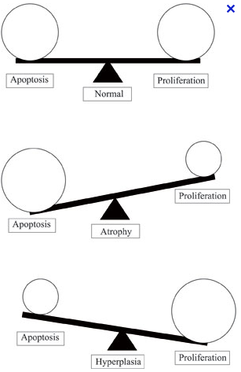

Slide 57
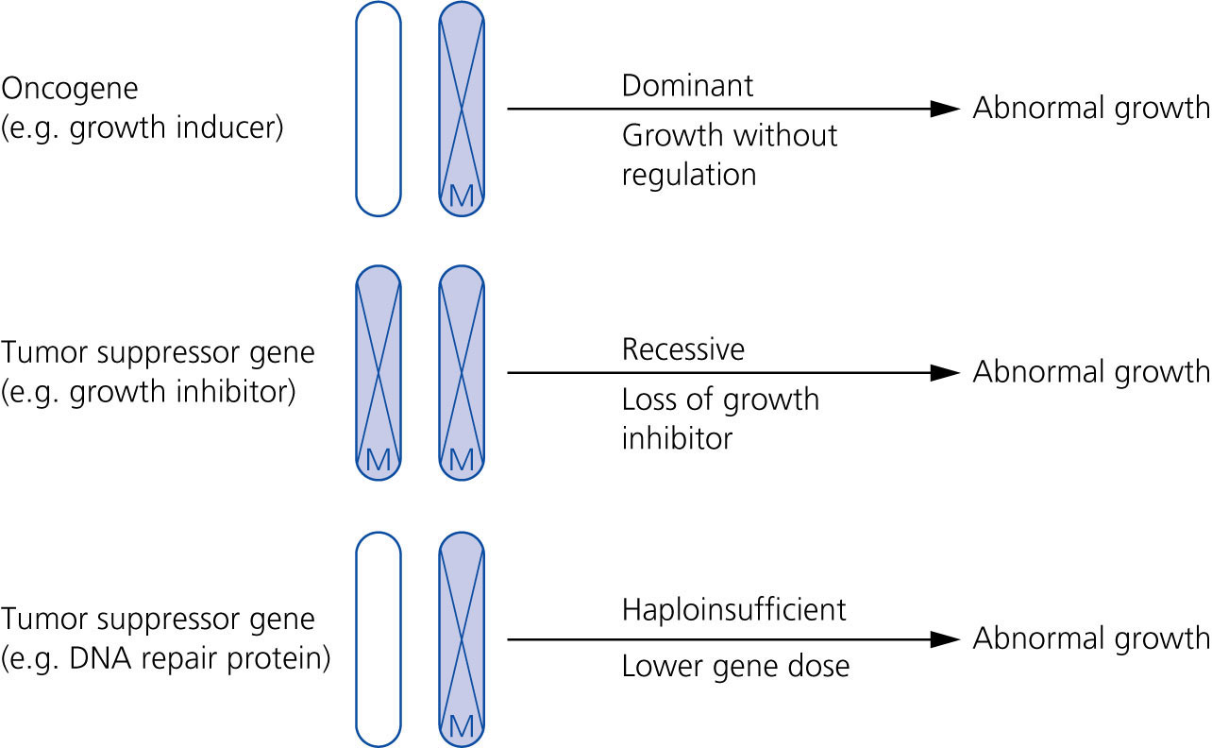
Pozitivni i negativni regulatori

Slide 58
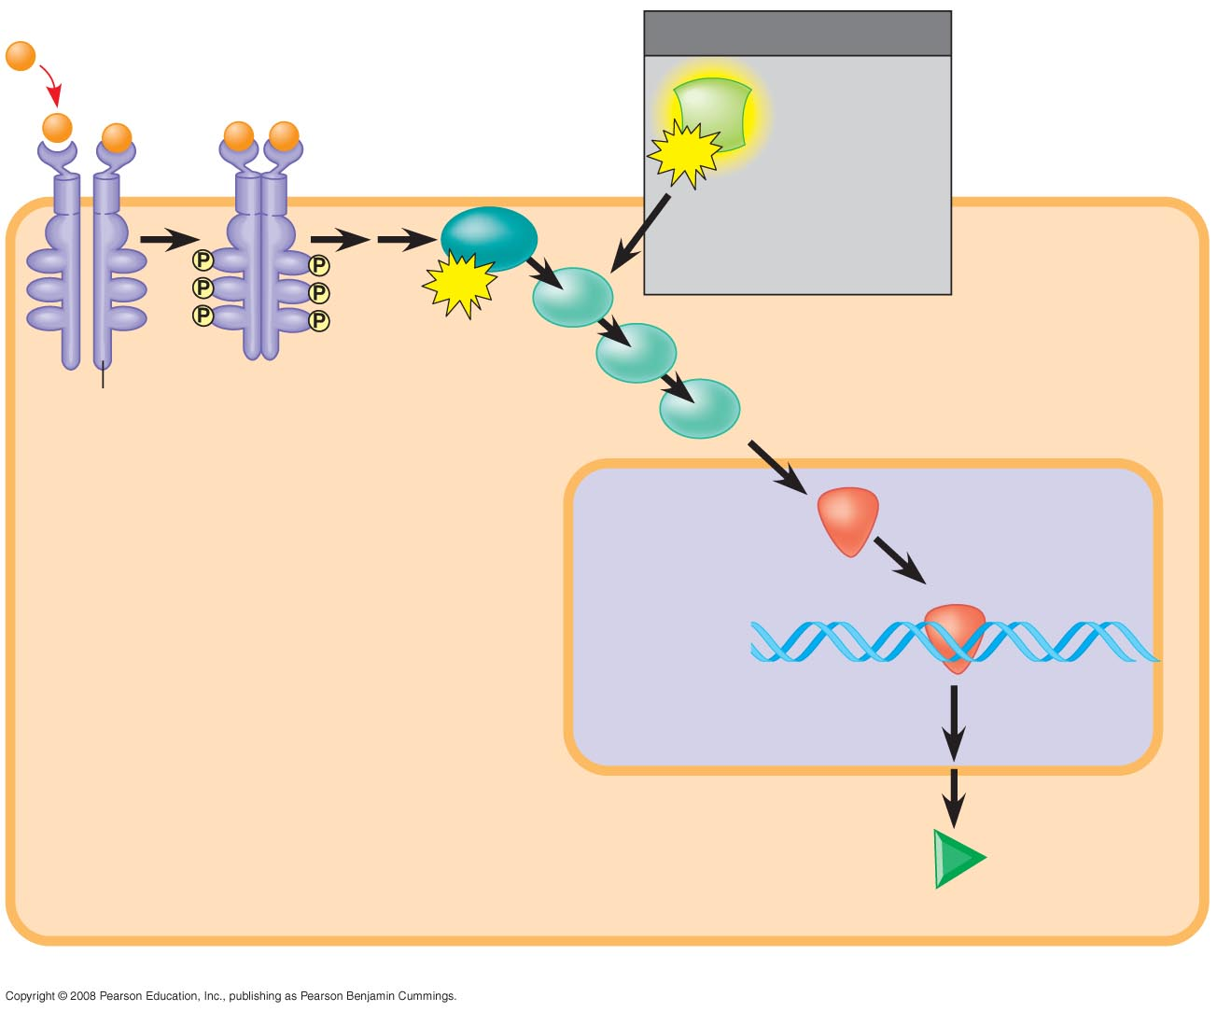
Fig. 18-21a
1
Growth
factor
1
MUTATION
Ras
Hyperactive
Ras protein
(product of
oncogene)
issues
signals
on its own
3
G protein
GTP
Ras
GTP
2
Receptor
4
Protein kinases
(phosphorylation
cascade)
NUCLEUS
5
Transcription
factor (activator)
DNA
Gene expression
Protein that
stimulates
the cell cycle
(a) Cell cycle–stimulating pathway
Notes:
Figure 18.21 Signaling pathways that regulate cell division

Slide 59
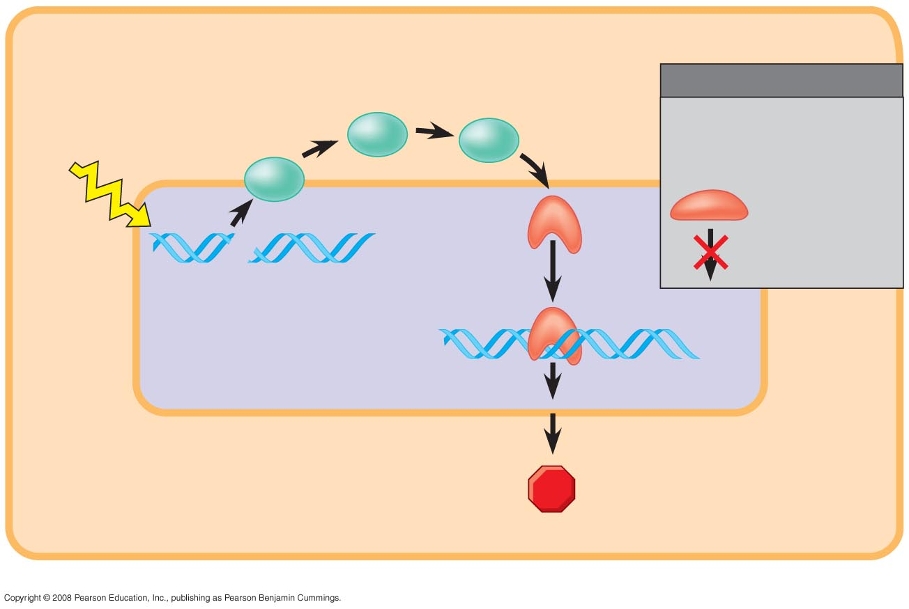
Fig. 18-21b
2
Protein kinases
MUTATION
Defective or
missing
transcription
factor, such
as p53, cannot
activate
transcription
UV
light
3
Active
form
of p53
1
DNA damage
in genome
DNA
Protein that
inhibits
the cell cycle
(b) Cell cycle–inhibiting pathway
Notes:
Figure 18.21 Signaling pathways that regulate cell division

Slide 60
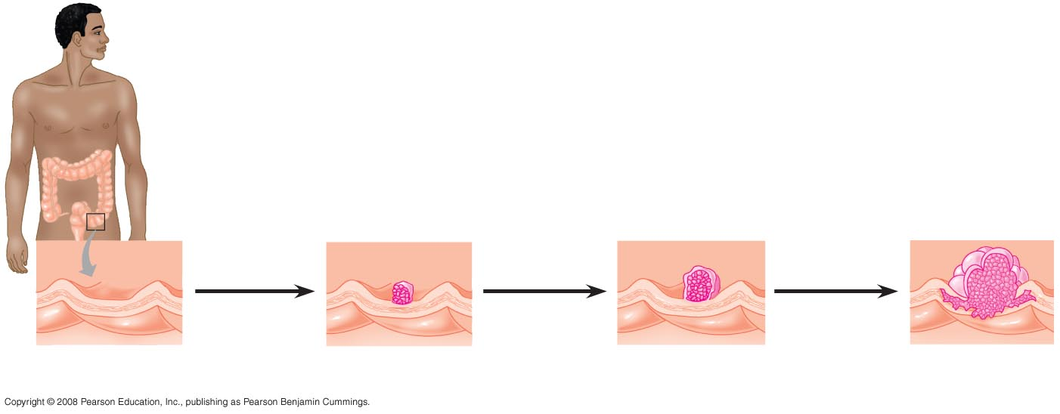
Fig. 18-22
Colon
EFFECTS OF MUTATIONS
Loss of
tumor-suppressor
gene p53
1
4
Loss of tumor-
suppressor gene
APC (or other)
Activation of
ras oncogene
2
Colon wall
Loss of
tumor-suppressor
gene DCC
3
Additional
mutations
5
Normal colon
epithelial cells
Small benign
growth (polyp)
Larger benign
growth (adenoma)
Malignant tumor
(carcinoma)
Notes:
Figure 18.22 A multistep model for the development of colorectal cancer

Slide 61
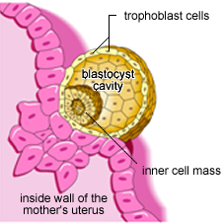
Osobine višestaničnih organizama koje stanice raka koriste:
Stanična invazivnost
Stanična mobilnost
Veliki broj stanica
Veliki kompleksni genom
Dugi životni vijek

Slide 62
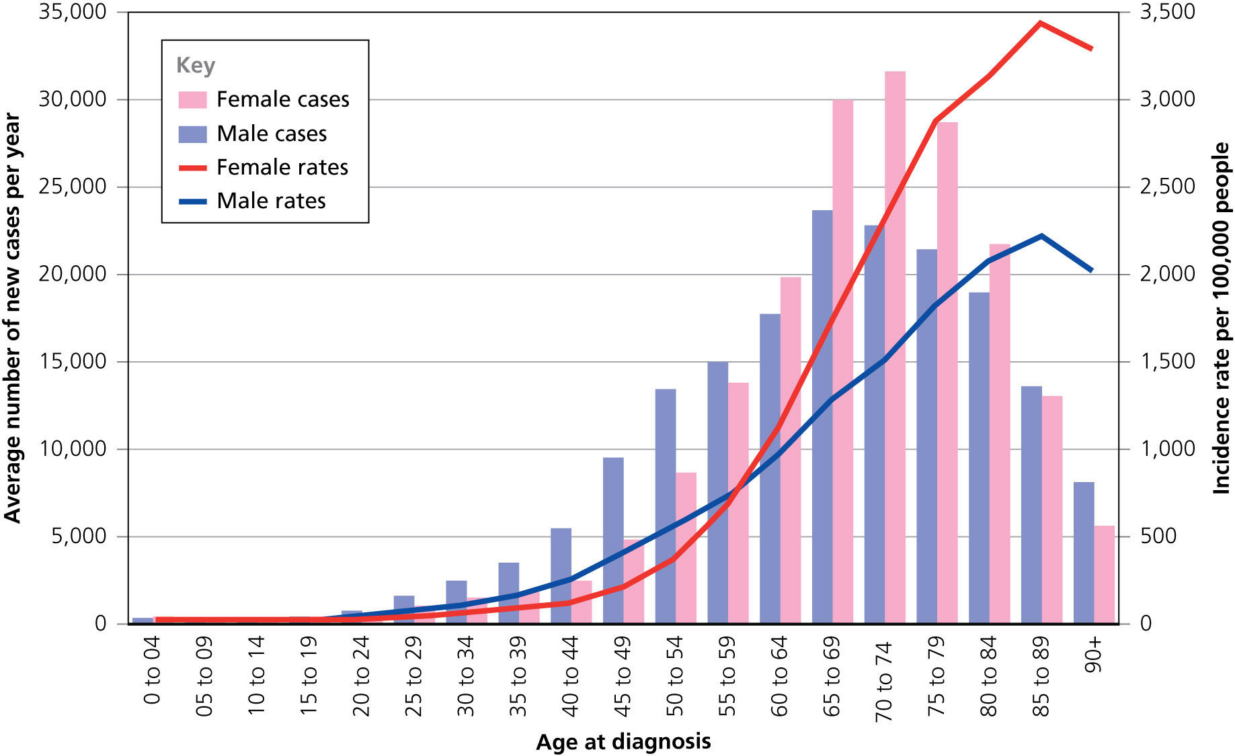
Rak – bolest starenja
Prikaz broja novooboljelih na 100000 ljudi ovisno o starosti
u UK za period 2015-2017

Slide 63

Životni vijek

